Slide 1
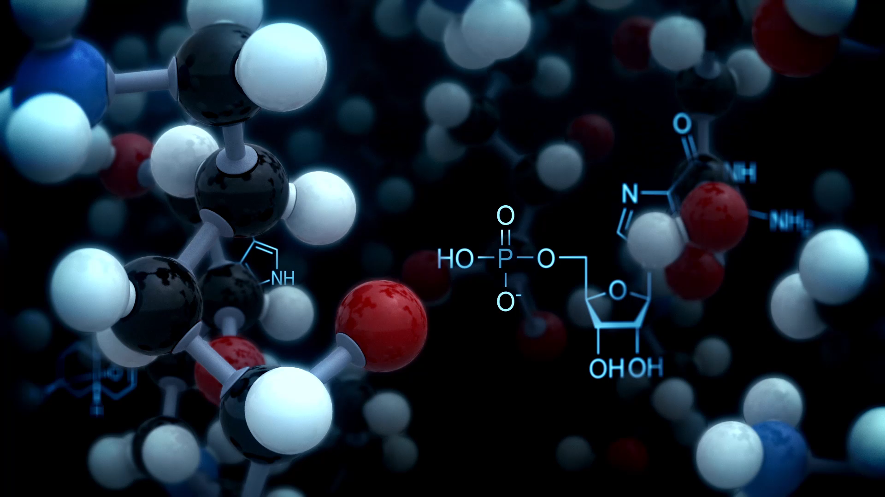
Molecular Robots Obeying Asimov's Three Laws of Robotics
Presented by: Dana Zorohov, Eldad Tsemach based on an article authored by: Gal A. Kaminka, Rachel Spokoini-Stern, Yaniv Amir, Noa Agmon, and Ido Bachelet.

Slide 2


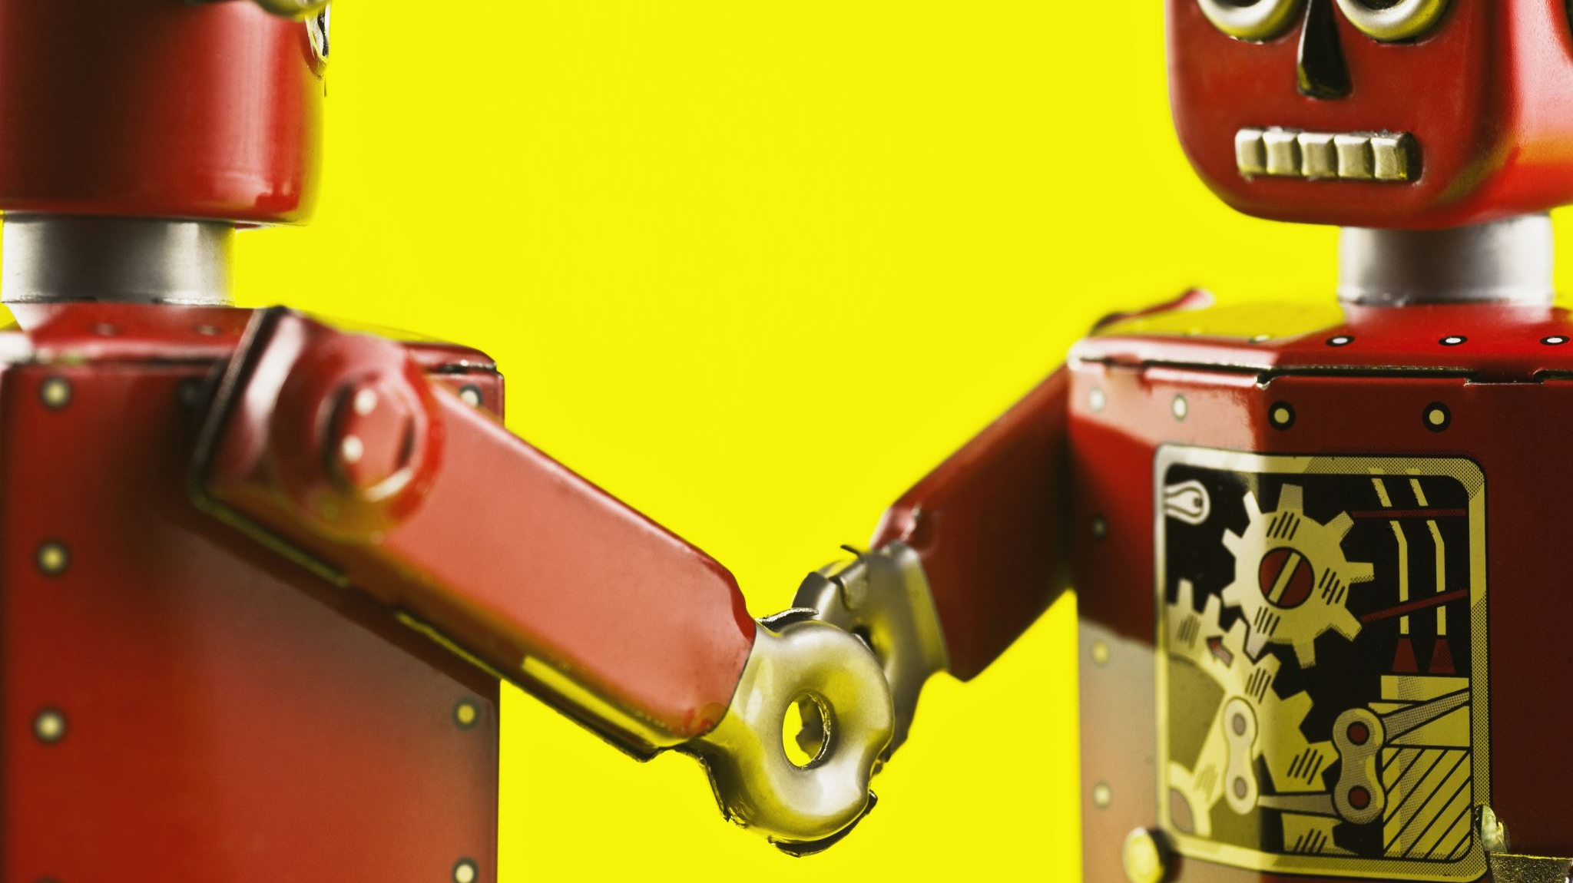
Abstract
The article explores how Asimov's three laws of robotics can be applied to molecular robots made from DNA origami.
These laws define rules for fictional robots to follow.
While implementing these laws in general robots is difficult, the researchers successfully programmed the molecular robots to obey a simplified version of the laws through interactions within a population of robots.
They even recreated a scenario from Asimov's story "Runaround" where a robot faces challenges despite following the laws.
The study demonstrates that complex ideas can be encoded and implemented at the molecular level by understanding robots based on their interactions.

Slide 3
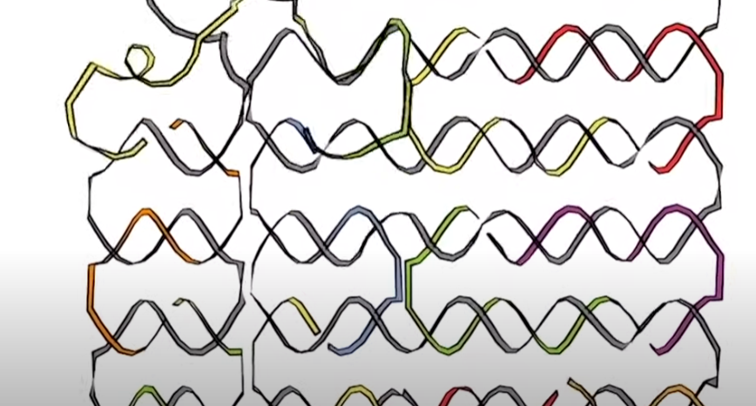
Introduction
DNA origami
DNA origami is the nanoscale folding of DNA to create arbitrary two- and three-dimensional shapes at the nanoscale.
DNA – large molecules inside of our cells. DNA can fold up like origami to create different nano structures.

Slide 4
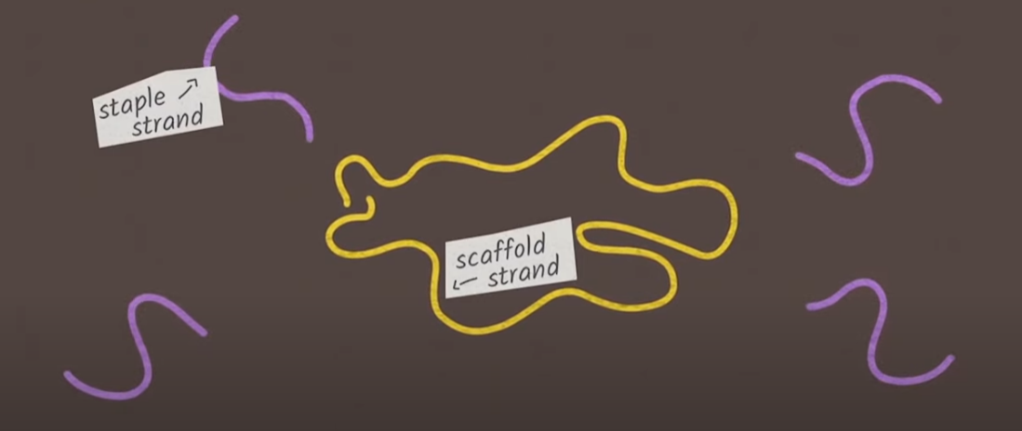
Introduction
DNA origami
In order to make this DNA nano structures, long pieces of DNA called “scaffold strand” , and short pieces called “staple strand” are used.
The scaffold create the structure, and the staple secure the shape created.

Slide 5
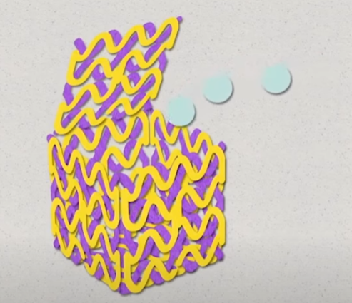
Introduction
DNA origami
Once the shape is created, the nano structure can be filled with medicine, closed, and sent it on it’s way.

Slide 6
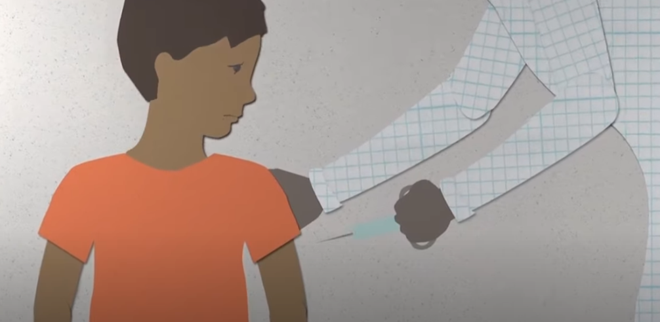
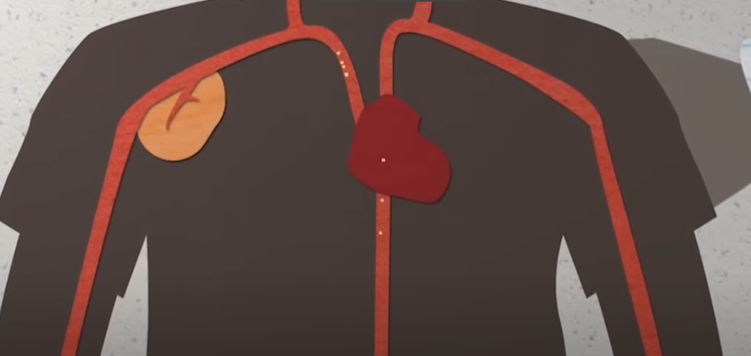
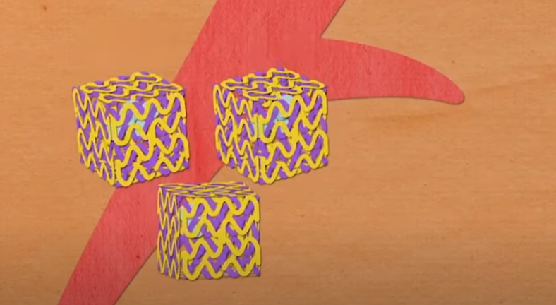
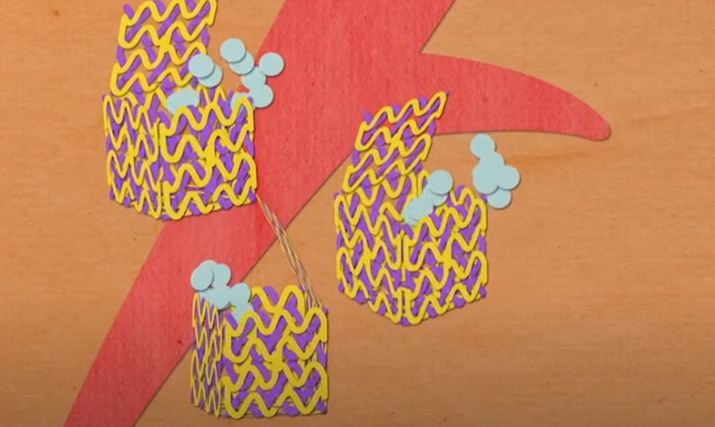
Introduction
DNA origami
For example, in drug delivery, the nano structure keeps the medicine inside until it gets to the right place, and prevent the medicine from attacking areas that were not supposed to.

Slide 7

Introduction
Three laws of robotics by Isaac Asimov:
L1: A robot may not harm a human being, or allow, by inaction, a human being to come to harm.
L2: A robot must obey orders given by a human being, unless these orders are in conflict with L1.
L3: A robot must protect its own existence, unless doing so is in conflict with L1 or L2.

Slide 8
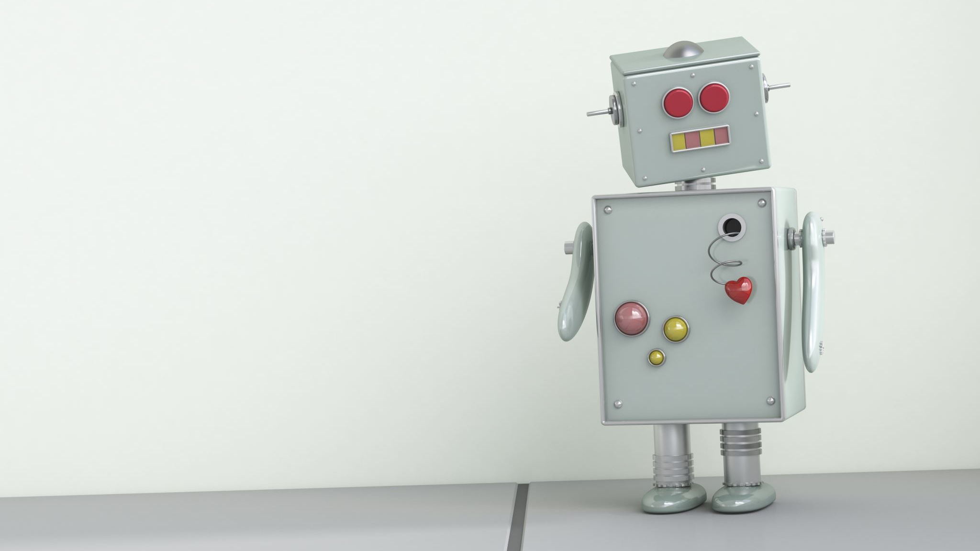
Introduction
Three laws of robotics by Isaac Asimov:
These laws became central to fictional literary works by Asimov and others who dealt with the foreseen integration of autonomous robots into human society, technology, and culture.
Together, these laws construct a reasoning process that a robot must undergo before making a decision of any kind. This process filters out any move that violates L1, L2, or L3 (in that order), assuming that no decision (including doing nothing) is allowed to bypass a stage in the process.

Slide 9
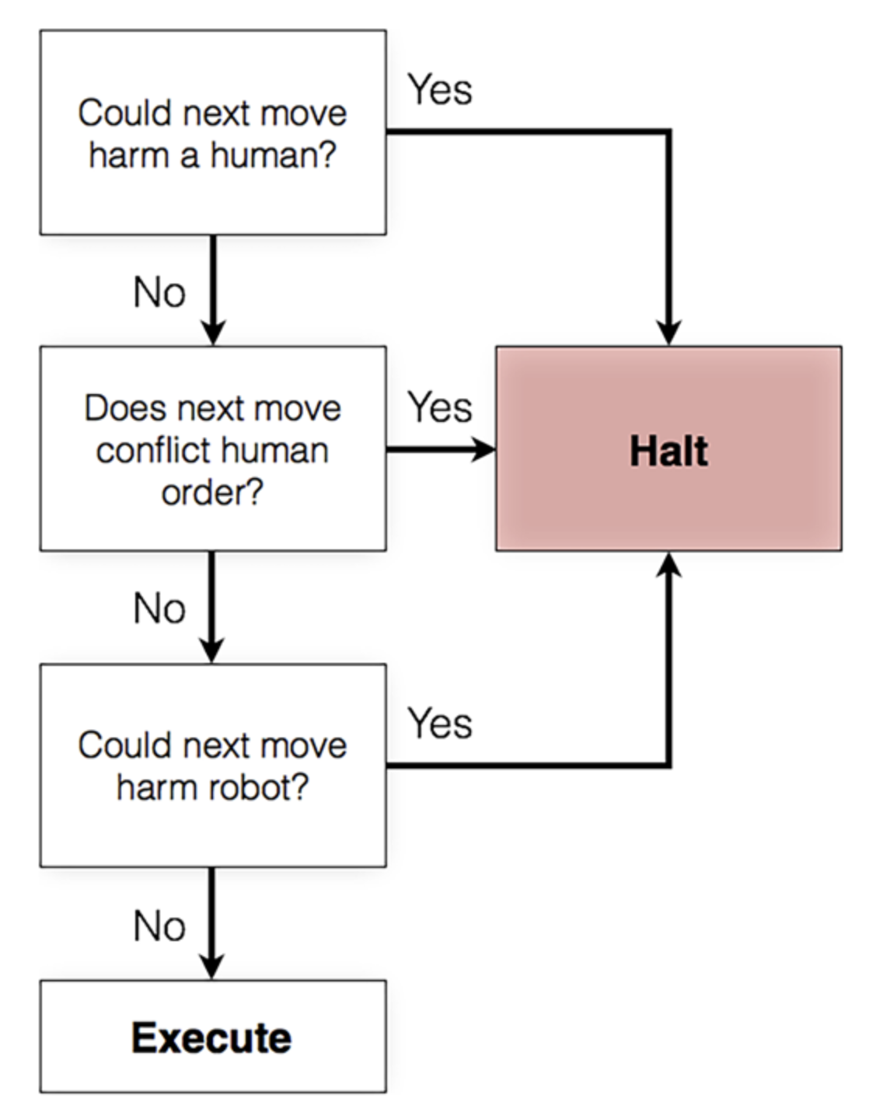
Introduction
Three laws of robotics by Isaac Asimov:
Figure 1
A reasoning process constructed by Asimov's three laws of robotics. A schematic representation of Asimov's laws as a flow diagram. Any move (including doing nothing) proceeds through this decision process without bypassing any stage, with moves that violate either one of the three laws being filtered out in real time.

Slide 10

Introduction
While Asimov's three laws of robotics are popular in science fiction, implementing them in real robots is considered impractical. However, researchers have developed limited versions of the laws to explore decision-making capabilities in artificial intelligence. These versions assume a single complex robot making decisions and applying the three-law filter process.

Slide 11
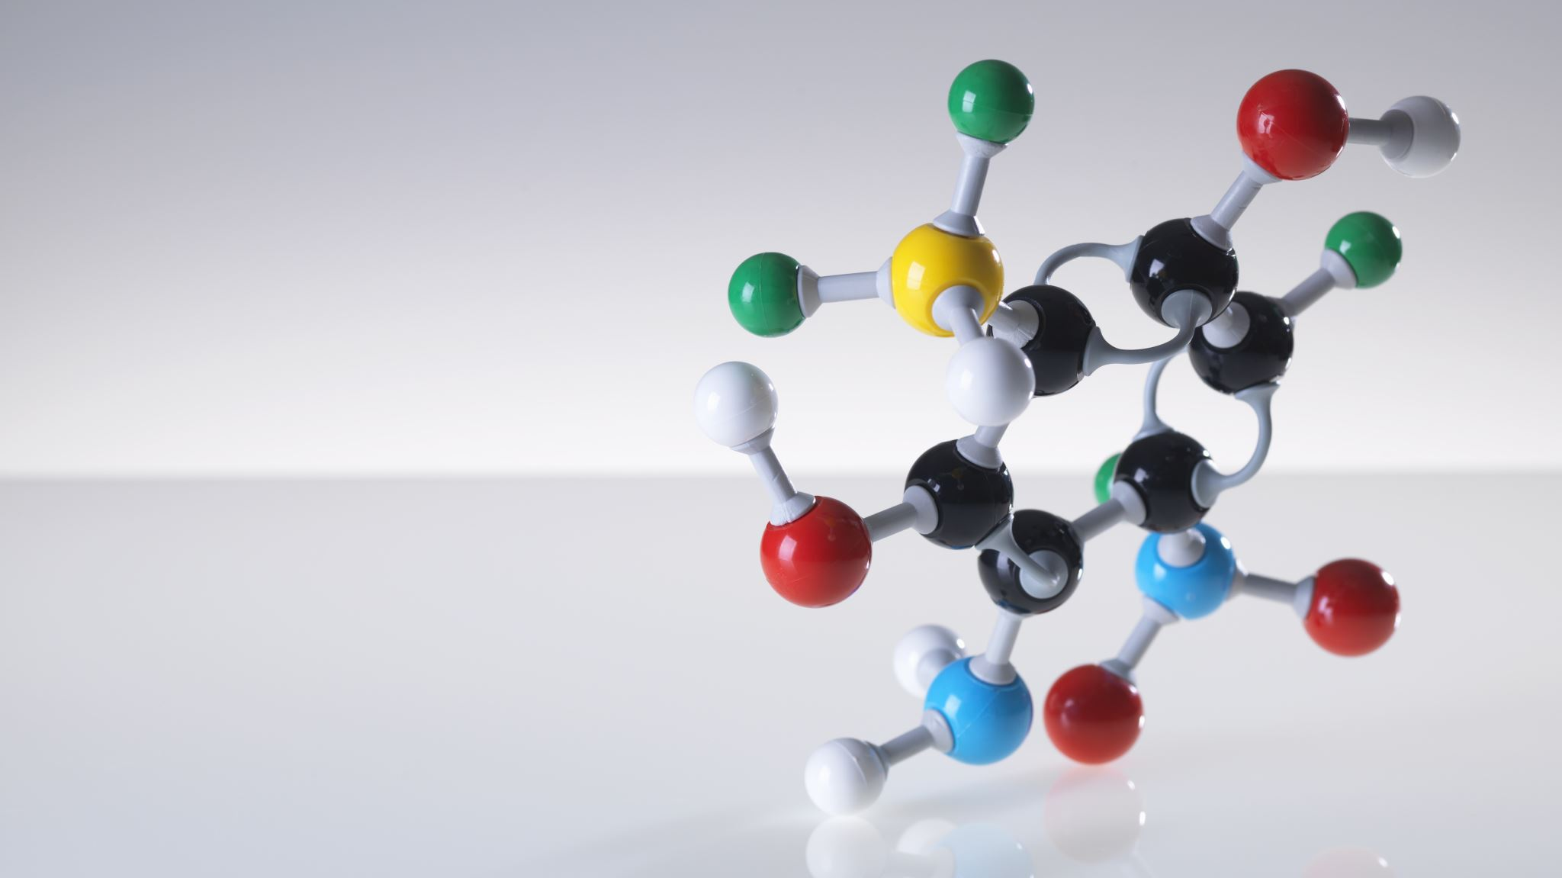
Introduction
Advancements in robotics have extended to the molecular scale, particularly with the use of DNA as a building block for molecular robots.
Three key factors have contributed to this progress:
Toehold-mediated strand displacement for actuation
Immobile DNA junctions for programmable nanostructure assembly
Aptamers for sensing environmental cues.

Slide 12
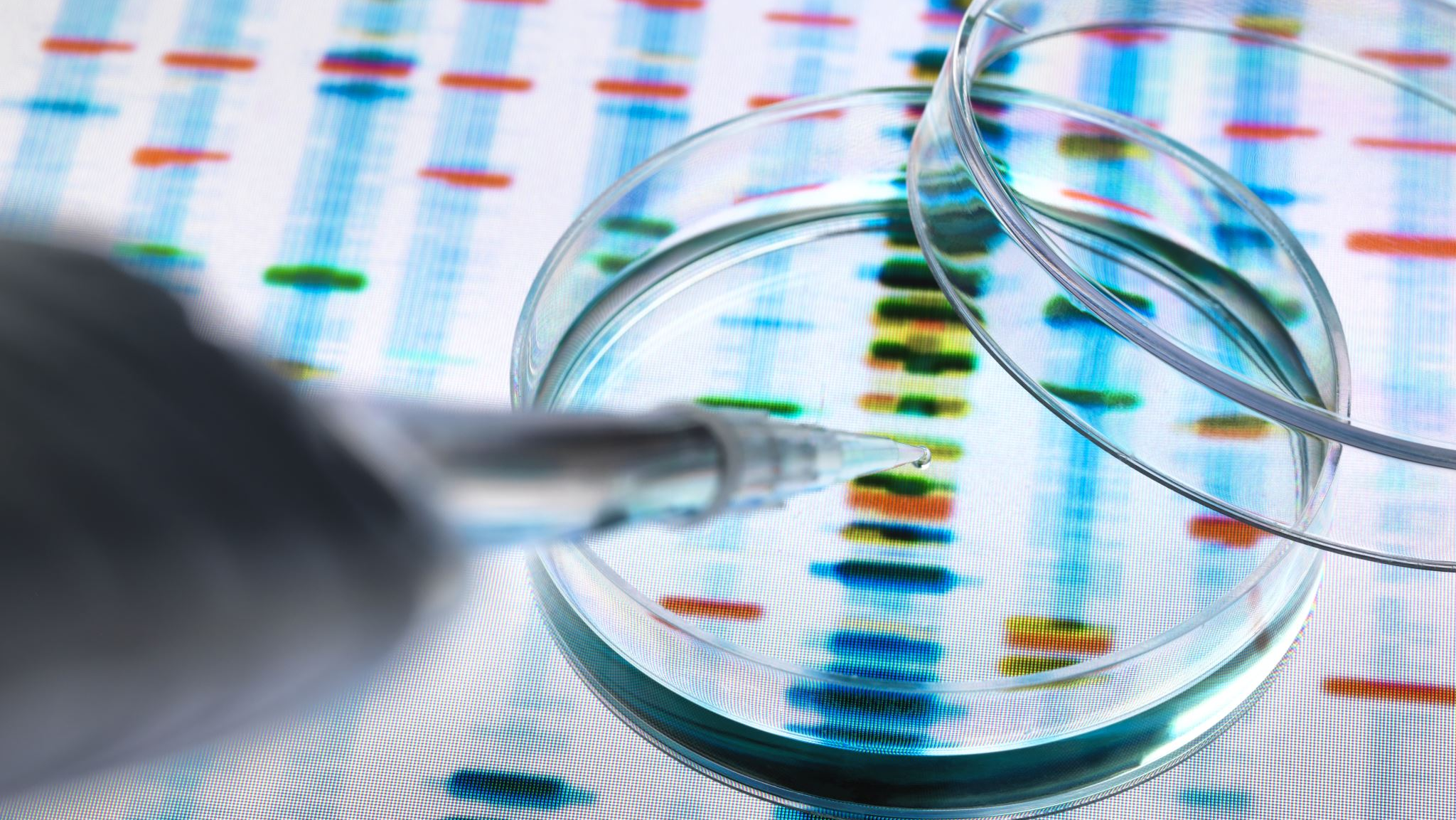
Introduction
Toehold-mediated strand displacement for actuation
It is a method used in DNA-based devices to make things happen or move. It involves using small pieces of DNA called "toeholds" as gatekeepers. These toeholds are designed to attach to a specific piece of DNA, blocking it from interacting with another matching piece.
When a specific trigger piece of DNA is introduced, it competes with the toehold to attach to the target DNA. The trigger DNA pushes the toehold away, freeing up the target DNA and causing a chain reaction of DNA interactions.
This process allows scientists to control and direct the movement or actions of DNA-based devices. By carefully designing the toeholds and trigger DNA, they can make the devices perform specific tasks or move in specific ways.

Slide 13
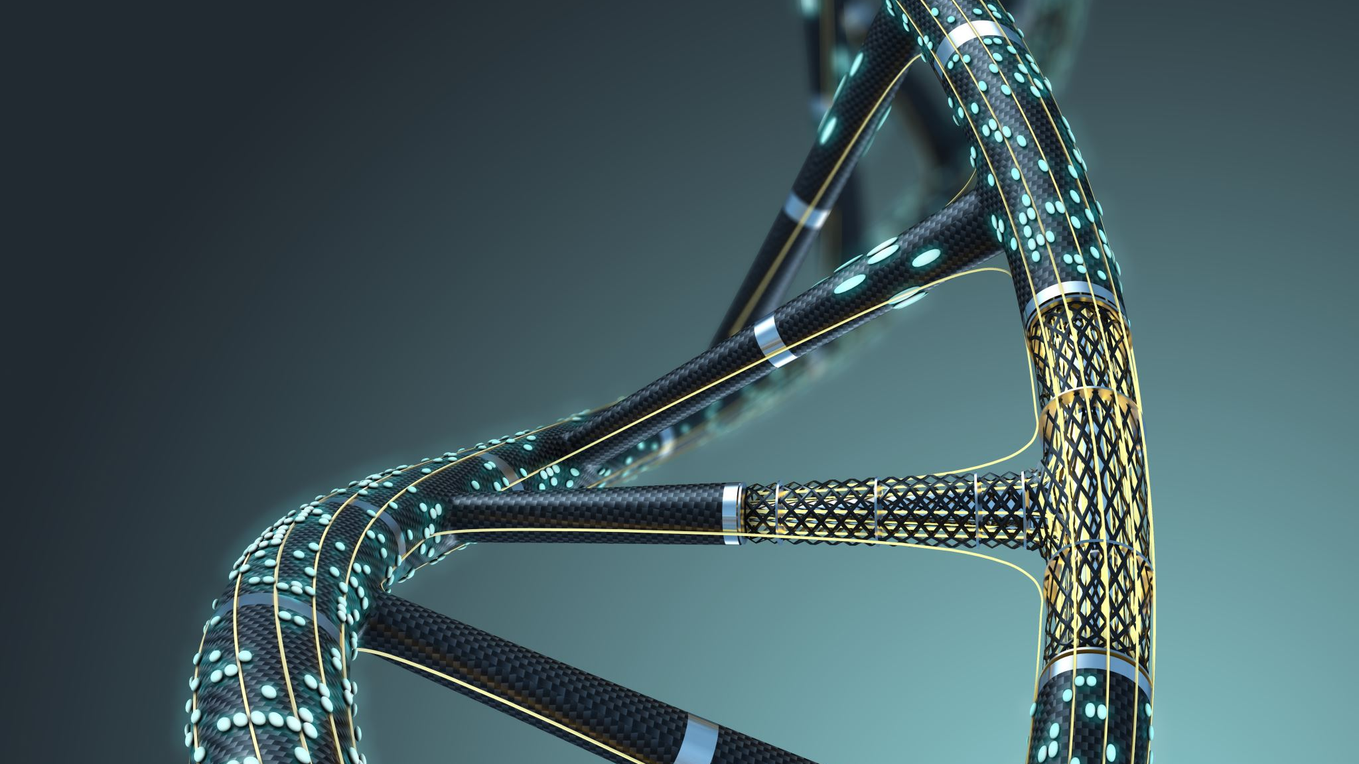
Introduction
Immobile DNA junctions for programmable nanostructure assembly
It refers to a technique where DNA is used to build tiny structures on a very small scale. In this method, DNA strands are arranged in a way that they come together and connect at specific points called "junctions."
These junctions are designed to be immobile, meaning they stay in place and do not move around. By carefully planning the arrangement of the DNA strands and their junctions, scientists can create different shapes and structures at the nano level.
This programmable assembly allows researchers to build custom nanostructures with precision and control. It's like putting together building blocks made of DNA to create small structures for various applications, such as in nanotechnology or biomedical research.

Slide 14
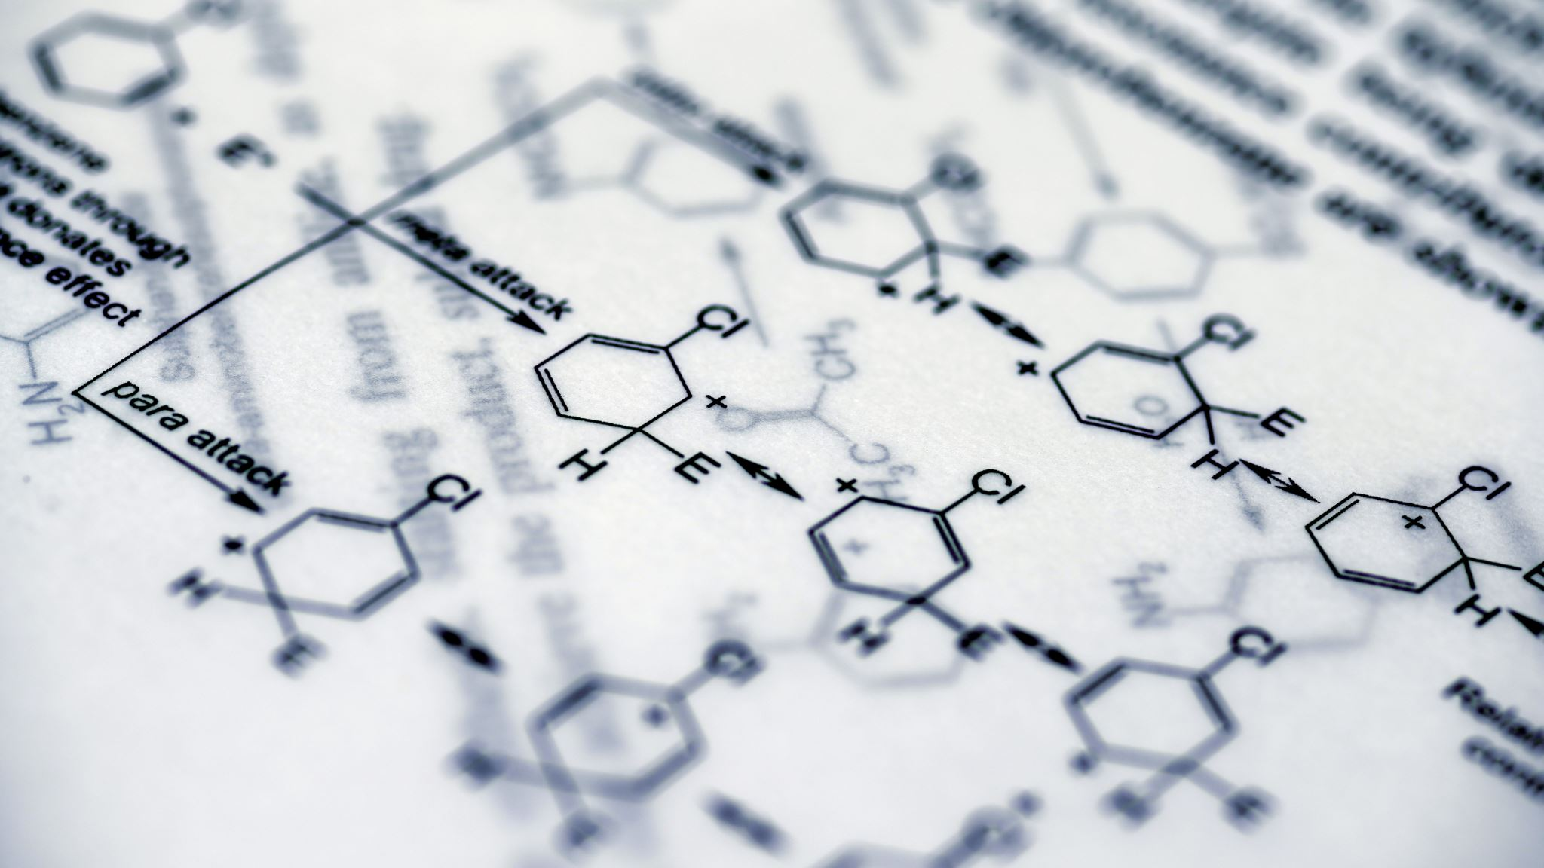
Introduction
Aptamers for sensing environmental cues.
Aptamers are special molecules that can sense or detect specific things in the environment. They are like tiny sensors made of DNA or RNA. Scientists design aptamers to bind or attach to particular substances or signals in the surroundings.
When an aptamer comes into contact with its target, it undergoes a change that can be detected. This change could be a physical or chemical reaction that indicates the presence of the specific substance or signal being sensed.
By using aptamers, scientists can create sensors that are highly sensitive and selective to specific cues in the environment. These aptamer-based sensors have applications in various fields, such as detecting pollutants, monitoring biological processes, or even diagnosing diseases.

Slide 15

Introduction
By combining these components, researchers have developed programmable DNA-fueled actuators, bipedal walkers, logic circuits, molecular computers, nanoscale factories, and robotic devices that connect sensing with actuation, even in biological systems.

Slide 16
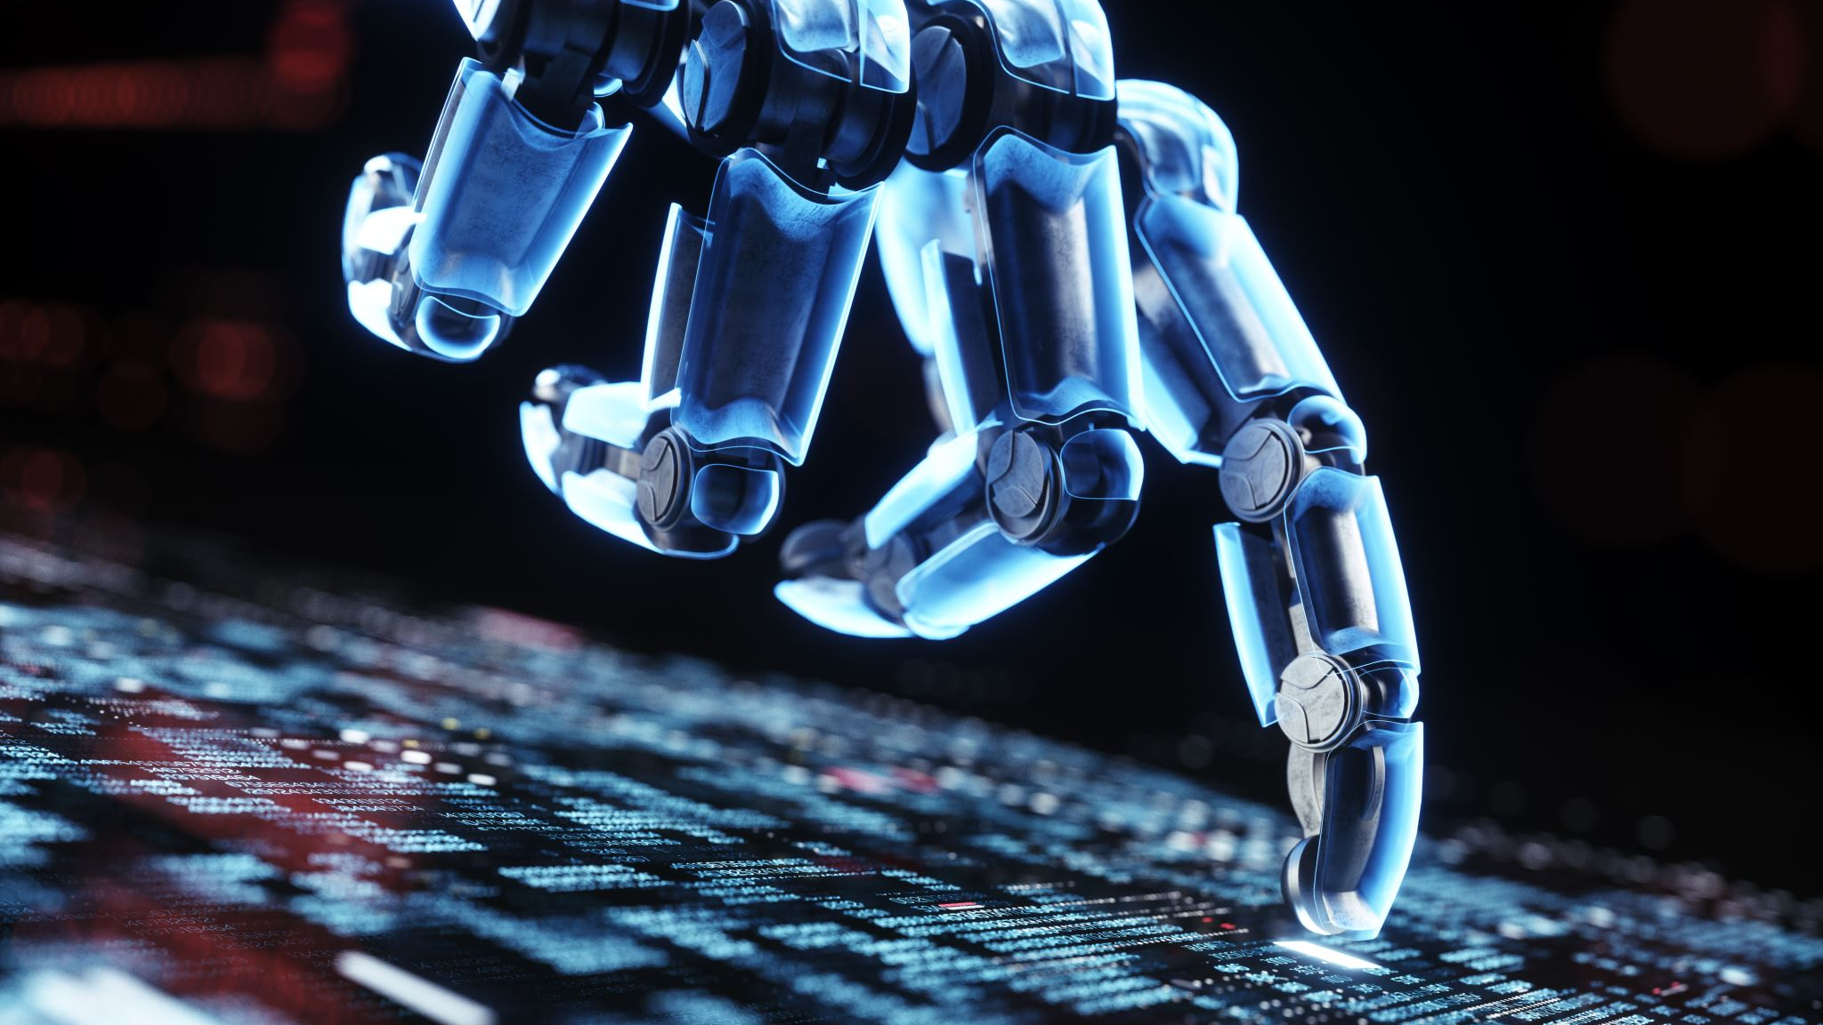
Introduction
Designing and fabricating molecular robots pose unique technical challenges compared to larger-scale robots. Molecular robots operate on different principles, and it's unclear how general robotics concepts can be applied to this scale. To explore this, the researchers developed a version of Asimov's laws implemented using molecular robots.
They focused on creating a mechanism that recognizes and responds to harm. Harm in a biological context can be detected through various molecular signals, such as abnormal presence of certain molecules or markers on cell surfaces. By using molecular sensors like aptamers, the robots can be programmed to detect these signals and take appropriate actions.

Slide 17
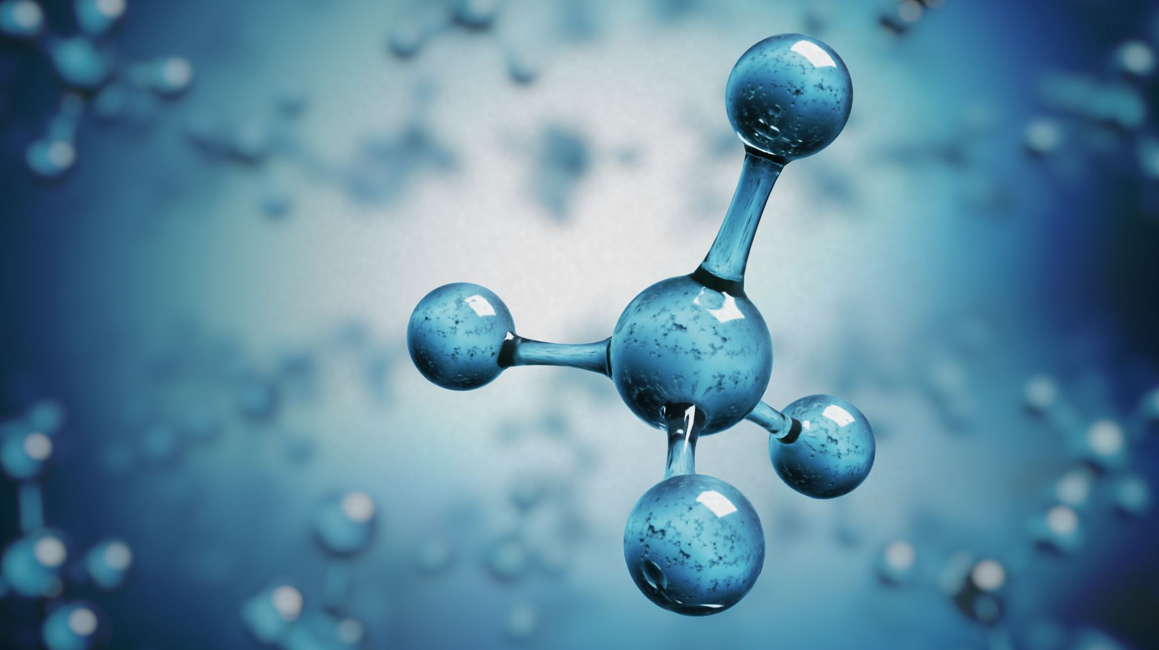
Introduction
As a proof of concept, the researchers chose a microRNA molecule called miR-16 as a signal for damage. They developed a sensor that can detect miR-16 using toehold-based strand displacement. Although miR-16 is released after cell damage occurs, the population of molecular robots can be programmed to respond to microscopic damage before it becomes a significant threat.
By employing numerous molecular robots, each causing only minuscule damage, they can collectively halt in response to potential harm.

Slide 18
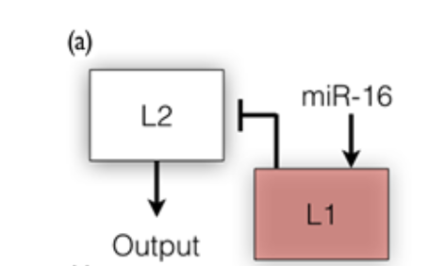
Results
For this study, modified versions of DNA origami robots were used.
These robots interact with each other to perform logical functions, which formed the basis of the design work.
By combining two types of robots (L1 and L2), a not gate was created, where miR-16 acted as the input and the robot’s activity served as the output.
Figure 2 A schematic of the not gate constructed by L1 and L2 robots. L1 robots sense miR-16 (an indicator of cellular damage), activate, and expose strands that force L2 robot closure.

Slide 19
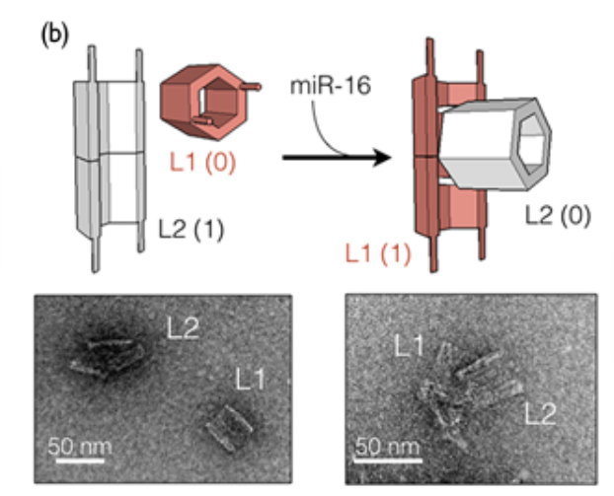
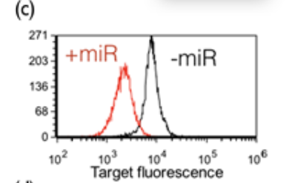
Results
When no damage was detected, the robots continued their task (L2: input = 0, output = 1), but upon detecting miR-16 at a specific concentration, they halted (L1: input = 1, output = 0). The design was successfully implemented using fluorescently tagged L2 robots, and the output was represented by their attachment to specific targets.
Figure 3: Schematic and corresponding representative TEM(*) images of robots at either state of the not gate.
Figure 4: Flow-cytometric analysis of L2 robot output in the presence (red) and absence (black) of miR-16.
(*) TEM stands for Transmission Electron Microscopy, and a TEM image refers to an image captured using this microscopy technique.

Slide 20
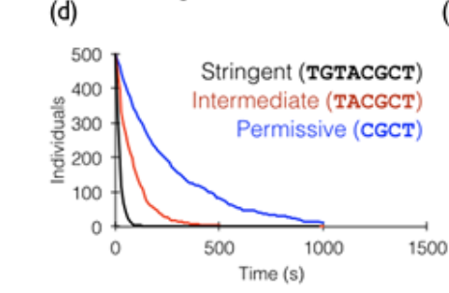
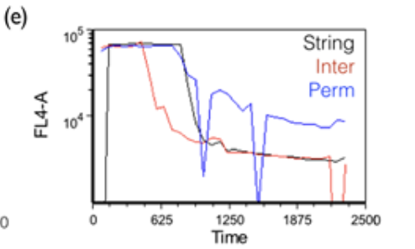
results
The concept of considering varying levels of risk in robot activity was also introduced, allowing for different degrees of stringency in the reaction. This was confirmed through simulations and experiments with the robots.
Figure 5: Visual DNA Strand Displacement simulations of the stringency of L1 closure of L2. Shown sequences are those of the clasp arm of L1, which hybridize with L2 gate toeholds at varying kinetics depending on length.
Figure 6: Experimental validation of the Visual DNA Strand Displacement simulations (FL4-A, target fluorescence; string, stringent; inter, intermediate; perm, permissive; graph colors correspond to colors in fig5).

Slide 21
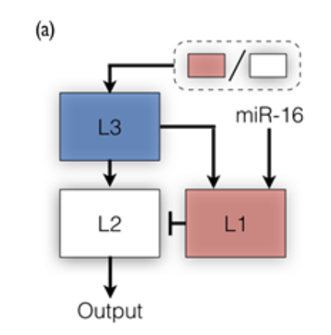
Results
For the L1-L2 not gate to work correctly, it is important to have the right amount of L1 and L2 robots.
If there are too many L2 robots, the system becomes overly active.
On the other hand, if there are too many L1 robots, the system remains suppressed indefinitely.
To maintain the necessary L1:L2 ratio, a third type of robot called L3 was designed.
L3 acts as a physical support or structure that enables interaction between L1 and L2 robots only when they are present in the correct proportion.
Figure 7: A schematic of the L1-L2 logical not gate integrated with L3 that senses the L1:L2 ratio and provides a physical platform for L1 and L2 to function.

Slide 22
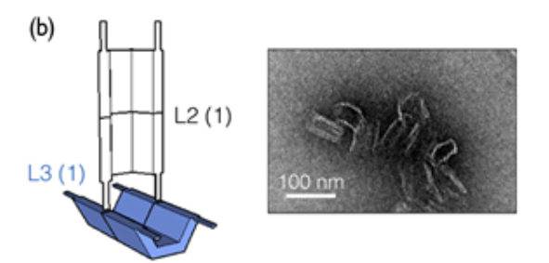
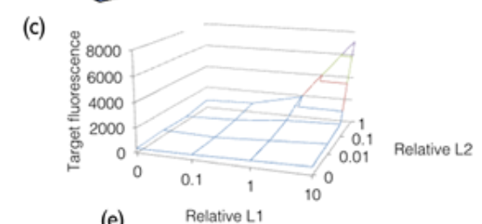
results
Figure 8: A schematic and the corresponding representative TEM image of L2 and L3 robots attached to each other according to the system design.
Figure 9: Experimental validation of L3 state (as measured by fluorescent signal on target microparticles) at various L1:L2 ratios, showing response at a ratio of 10:1.

Slide 23
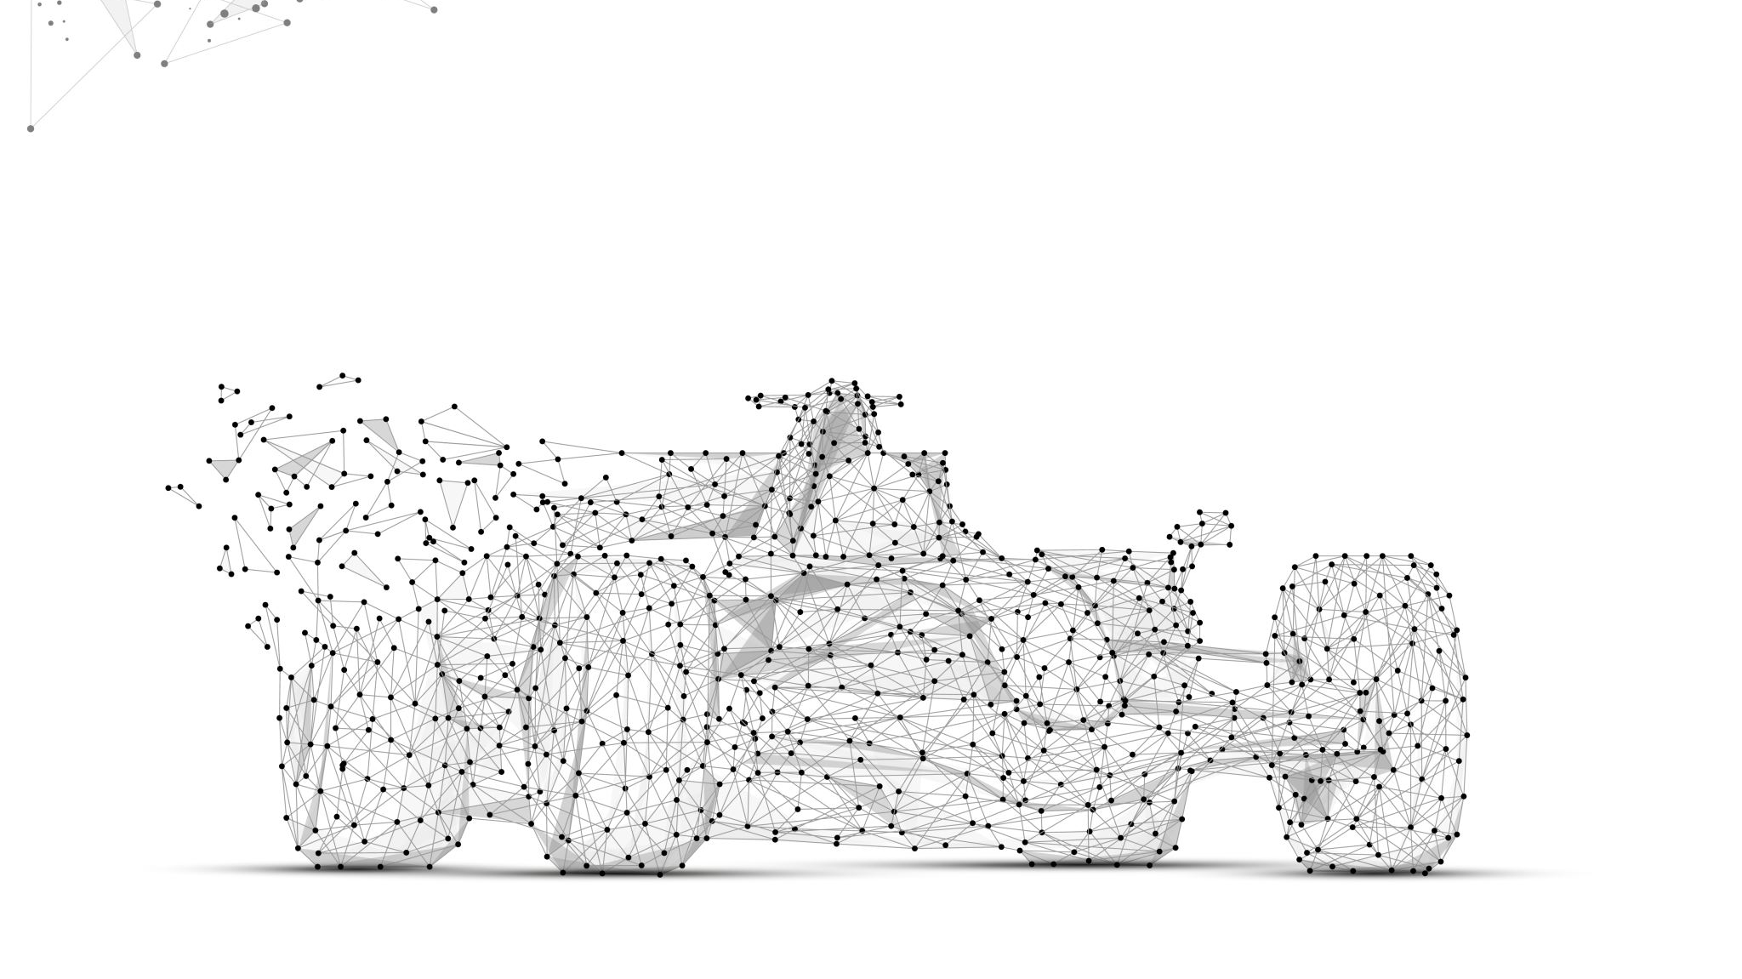
results
To ensure the proper ratio of L1 and L2 robots, the L3 robots are programmed to respond accordingly.
The design of a single L3 robot requires the displacement of both L1 and L2 gates for it to open, and the displacement of each arm is adjusted to occur at a specific input concentration.
The inputs for the L3 robot come from DNA strands attached externally to L1 and L2 robots, which means that the L3 robot's response is directly linked to the concentrations of L1 and L2 robots.
The presence of a large number of robots compared to the required number allows some L1 and L2 robots to act as ratio indicators, while others physically interact with accessible L3 platforms to produce effects.
The design was tested using visual DNA Strand Displacement simulations and actual experiments with robots in solution under three different conditions: an incorrect L1:L2 ratio, a correct ratio without damage, and a correct ratio with damage.

Slide 24
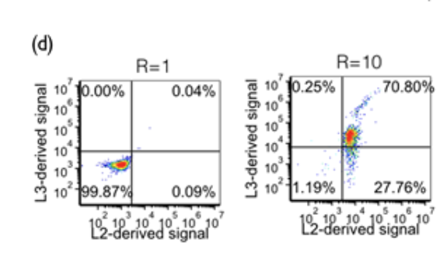
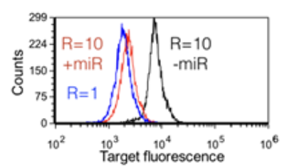
results
Figure 10: Experimental confirmation that L2 robots are not active at a wrong L1:L2 ratio, and that they are attached to L3 robots at the proper ratio, as shown by correlated double staining of target microparticles for L2 and L3 (at FL3 and FL1 channels, respectively). R = 1 and R = 10 denote L1:L2 ratios.
Figure 11: Flow-cytometric analysis of target microparticles at three system states: wrong L1:L2 ratio (R = 1, blue), proper L1:L2 ratio without miR-16 (R = 10, −miR, black), proper L1:L2 ratio with miR-16 (R = 10, +miR, red).

Slide 25
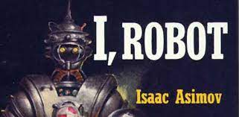
results
To demonstrate the capabilities of the molecular robots, the scientists recreated a scenario from Isaac Asimov's story "Runaround."
In the story, a robot named Speedy is sent on a mission out in the fatal heat of the surface of the planet Mercury to retrieve selenium to its human operators. But he gets stuck in a conflict between the second and third laws of robotics.
The robot's control is trapped in an equilibrium state where it is neither moving towards nor away from the selenium, causing erratic behavior.
It turns out that the selenium's position is leaking gas, which may destroy the robot.
The command to the robot (second law) was given casually, making it a low-priority command.
And as Speedy approaches the danger, the third law (which in Speedy is particularly strengthened because of the cost of the robot) kicks in at a level that exactly counterbalances the urgency of the command given to it.
In other words, moving away from the selenium and danger causes the second law to become stronger, driving the robot towards the selenium.
But moving closer to the selenium and danger strengthens the third law and drives the robot back.
The human operators finally manage to break Speedy from the equilibrium trajectory by putting themselves in danger, causing the first law to kick in and override both other laws.

Slide 26

results
In the scientists' experiment, they designed the robots with L1, L2, and L3 components in the correct ratio.
They induced a conflict between L2 and L3 by closing the L3 robots using specific DNA strands, simulating an imbalanced L1:L2 ratio.
This resulted in a decrease in L2 robot activity, establishing a new equilibrium.
Then they introduced a conflict between L1 and L2 by adding miR-16, activating the L1 robots and further reducing L2 activity.
Eventually, the system reached a near-baseline activity level, resembling the equilibrium state described in the story.
By recreating the "Runaround" scenario, they demonstrated the dynamic behavior and response of the molecular robots under different conflicts and equilibrium conditions.

Slide 27
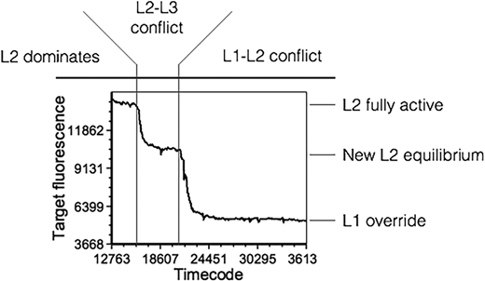
results
Figure 12: Experimental recreation of “Runaround” scenario using the L1-L2-L3 system. Real-time flow-cytometric analysis showing the fluorescent signal on target microparticles, that derive from active L2 robots.

Slide 28
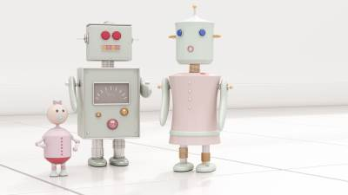
discussion
By shifting their perspective on decision making in robots, the scientists show that molecular robots can follow Asimov's laws.
Unlike traditional deterministic robots, the behavior of individual molecular robots is not predictable.
However, when working with large populations of these robots, their statistical nature allows for reliable implementation of the laws.
In the "Runaround" experiment, they successfully replicated the conflicts described by Asimov, despite the stochastic nature of each robot and the differences between actual and planned ratios.
The observed results are the collective outcome of approximately 100 billion robots.

Slide 29
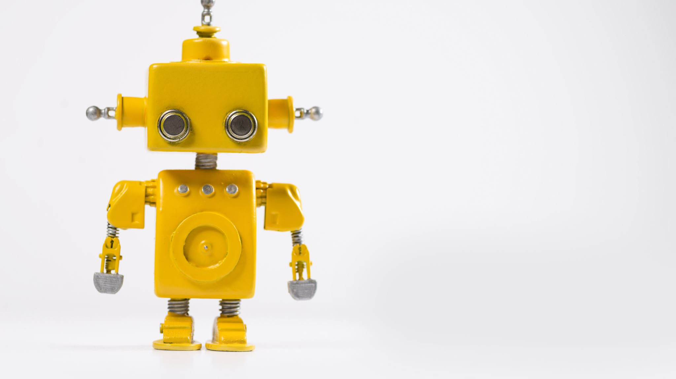
discussion
The mechanism developed in this study addresses the first part of the first law of robotics, which is to prevent harm.
However, addressing the second part of the law, which is to prevent harm by inaction, is more challenging.
For example, in the case of healing, L1 robots should support and enhance the operation of L2 healing robots.
Deciding on whether harm is caused by an action taken is difficult enough.
Deciding on whether harm is caused by not taking an arbitrary action at any arbitrary time is clearly impractical (if not impossible).
There is no general solution, but for each task, a specific combination of L1 and L2 robots is designed to carry out the task while considering the context and knowledge of the robots.
For surgery, L1 robots prevent overacting of L2 robots, while for healing, L1 robots trigger the operation of L2 healing robots.

Slide 30
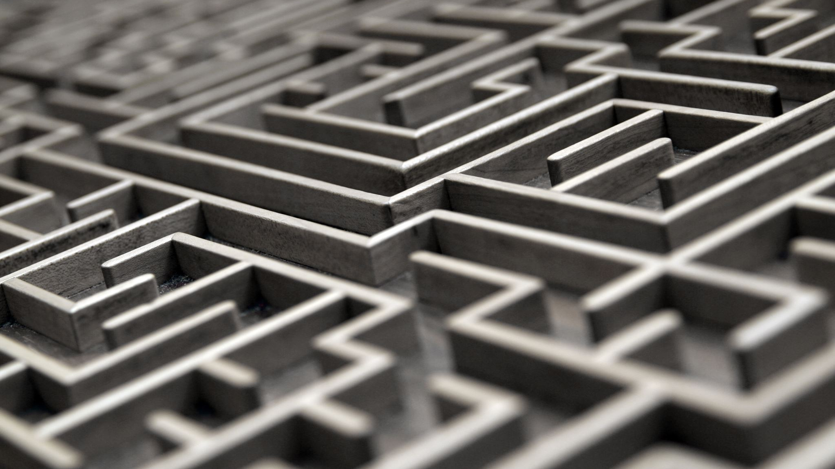
Summary
The proof of principle the scientists demonstrated has two important implications.
Firstly, DNA machines have the potential to be used in therapeutics that can monitor and prevent their own adverse effects.
This technology could be designed to respond to specific harm signals at different levels of sensitivity, enabling a wide range of tasks.
Secondly, a technology that is inherently incapable of causing harm raises interesting philosophical and ethical questions.
It highlights unique characteristics that may be inherent in molecular entities and opens up new possibilities for safe and responsible applications.

